Slide 1
Library Assessment Tools & Technology
LibQUAL+

Slide 2
LibQUAL+
LibQUAL+ from ARL is a Web-based survey to help libraries solicit, track, understand, and act upon users' opinions of service quality. The program's Web-based survey helps libraries assess services.
Some of the goals are to:
  Help libraries better understand user perceptions of library service quality
  Collect and interpret library user feedback systematically over time
  Provide libraries with comparable assessment information from peer institutions

Slide 3
LibQUAL+ Pros & Cons
Benchmark of users perceptions of Library services if used over a number of years
Able to compare your Library with similar institutions
Data is collected and analyzed by LibQUAL+ staff
Raw data is available for local analysis
Results report compiled by LibQUAL+ staff
Free form comments are gathered and submitted to the library in real time.
Cost can be prohibitive $3200.00. There are other pricing models
Survey is long……22 core questions each with 3 parts (students have complained about the length in the comment section)

Slide 4
LibQUAL+ in Library Assessment
Gap Theory of Service Quality gives information on what the users expect from the library as well as how they perceive the level of service received.
Enables benchmarking at local, national and international level.
Able to see perceptions of services from different user groups
Graphic and numerical data in the Results Reports have enabled the library to present data to our faculty and students

Slide 5
LibQUAL+ in Library Assessment
Comments attached to the survey have given us the best information to make changes and improve our services.
Comments are aggregated and analyzed by type of comment and user group.
Action plans developed.
Allowed the Library to address easy fixes quickly
Some issues were going to be addressed by other campus departments (Self serve printing & VPN)
Complaints about noise were addressed by changing furniture
Most recent survey reflected a strong desire for 24/7 access

Slide 6
LibQUAL+ the Survey
The Survey consists of 22 core questions in 3 areas:
  Affect of Service
  Information Control
  Library as Place
  Participants are asked to rate their minimum service level, their desired service level and perceived service level for each question
  5 additional questions can be added from individual libraries
  Questions about usage patterns and demographics

Slide 7
LibQUAL+ the Survey
LibQUAL+ has a Lite version of the survey that sends 7 core questions to selected recipients using item sampling methods.
We select the time to hold the survey
Provide the marketing and incentive prizes
Send out the invitations to participate with a URL to the survey.
LibQUAL+ has a website providing:
  Suggestions for IRB submission
  Examples of Marketing material from other Libraries
  Many articles on the survey design and history of LibQUAL+ and LibQUAL+ Lite.

Slide 8
LibQUAL+ Survey Results
Results are provided for Undergraduates, Graduates, & Faculty
Ratings for all questions are tabulated
Radial graphs and Adequacy graphs for each group
Demographic and Library usage data

Slide 9
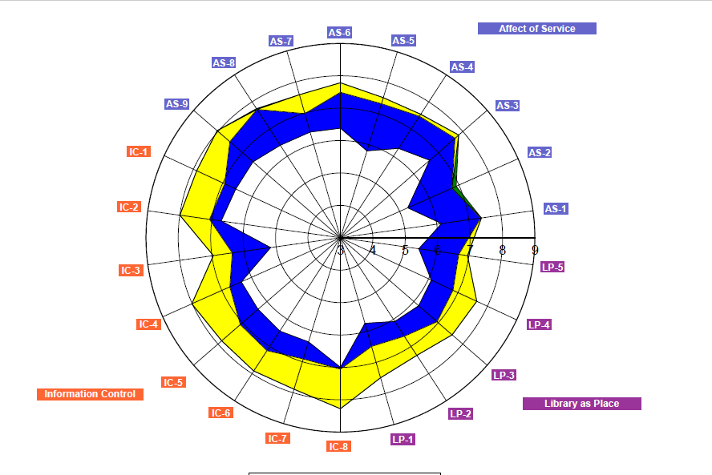
LibQUAL+ Results

Slide 10
LibQUAL+ Solutions
Ability to assess services regularly without undue staff time.
Continuity of effort if assessment staff leaves
Ability to assess services as expectations of students change.

Slide 11
LibQUAL+
Why use this tool?
Standard set of core questions allows comparison over years
Ability to compare our results with other libraries
Frees up staff time
Comments have provided a wealth of information from students and faculty

Slide 12
Thank you
Patricia Andersen
Access Services & Assessment Librarian
Colorado School of Mines
panderse@mines.edu

