Slide 1
Learning is not a service.
Zoe Fisher
Assistant Professor, Pedagogy & Assessment Librarian
Auraria Library
Library Assessments Workshop at University of Denver
Friday, November 18, 2016

Slide 2
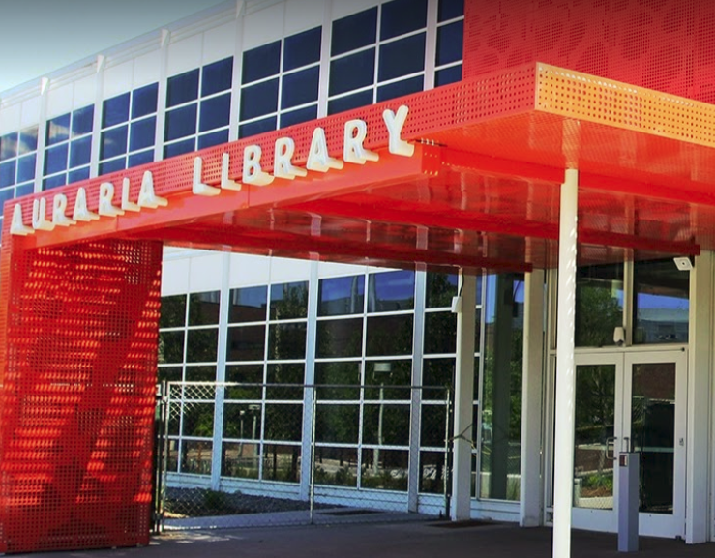
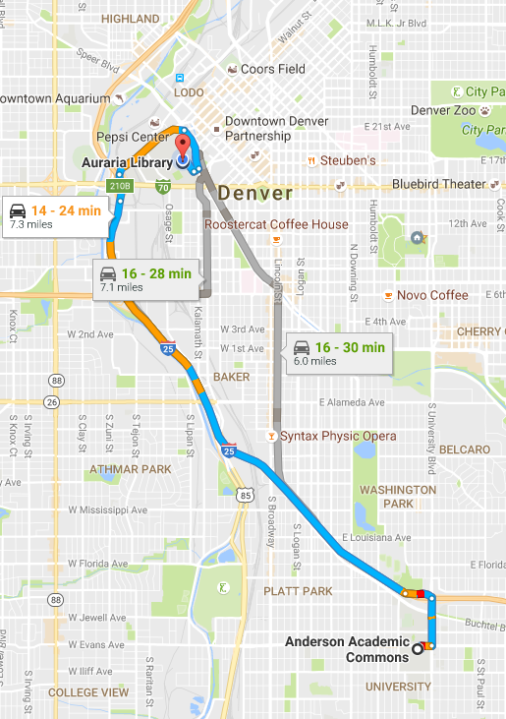
Images courtesy Auraria Library and Google Maps

Slide 3

As an information literacy librarian,
I am concerned with student learning outcomes, not student satisfaction with services.
Image from pixabay.com

Slide 4

How do we measure “service”?
Was it helpful?
Was it useful?
Was it satisfying?
Was it comfortable or pleasant?
Image from pixabay.com

Slide 5
What happens when we measure information literacy instruction as a service?

Slide 6
Service-Oriented Questions
“Was this instruction session helpful to you?”
“What was the most useful thing you learned today?”
“How confident do you feel about using the library catalog?”
“Are you comfortable working with the librarian?”

Slide 7

Think about a time that you learned something that was fairly challenging for you.
Image from pixabay.com

Slide 8
How did you feel while you were learning that challenging thing?
Image from pixabay.com

Slide 9
Satisfaction with instruction doesn’t necessarily mean students are learning.
Dissatisfaction with instruction doesn’t necessarily mean students are not learning.

Slide 10
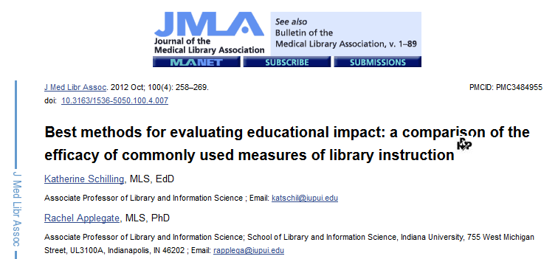
Image from PubMed Central

Slide 11

Source: “Best methods for evaluating educational impact: a comparison of the efficacy of commonly used measures of library instruction” (Schilling & Applegate, p. 266, 2012)

Slide 12
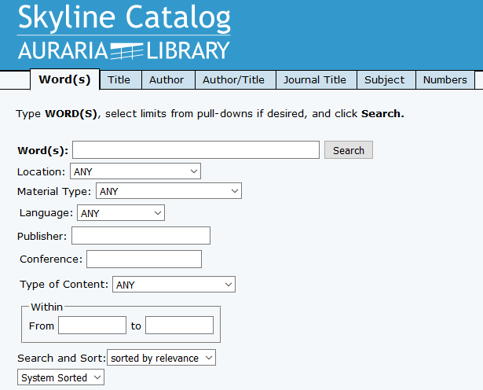
If a student says,
“I feel confident using the library catalog” – what does that actually tell you about that student?
Image from http://library.auraria.edu

Slide 13
It tells you that they feel confident about using the library catalog.
Image from http://library.auraria.edu

Slide 14
What are some alternate questions you can ask to measure student learning, instead of measuring satisfaction or confidence?

Slide 15
Learning-Oriented Questions

Slide 16
What will you do differently based on what you learned today?
What are the next three steps you’ll take with your project/assignment after today’s session?
How would you summarize what you learned today in 25 words?
With the knowledge you have now, what are the two things you need to learn next?
How will you “level-up” your current skills after today’s session?

