Slide 1
“Guerrilla Assessment”: Make It Manageable
Carol Smith, University Librarian, Colorado School of Mines
Library Assessments Workshop, November 18, 2016

Slide 2
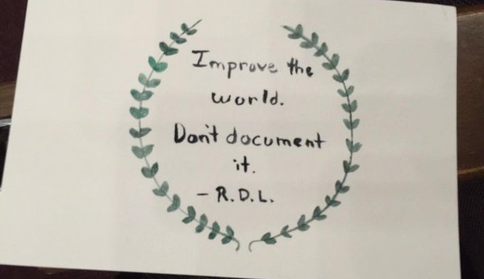
Notes:
Meaningful: impact/improvement
Quick review of strategic planning process
ACRL Standards for Libraries in Higher Education
Achievable assessment
Meaningful assessment
Assessment deliverables
First steps (group work and individual homework)
Impact (vs. just # of volumes – if the data doesn’t lead to impact/change, it isn’t meaningful assessment)

Slide 3
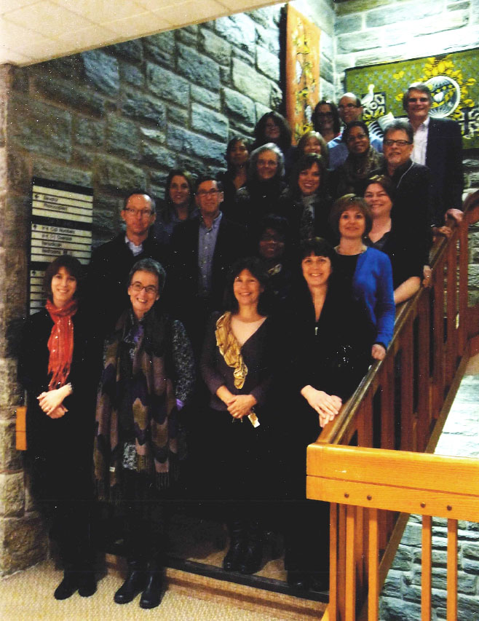


ACRL College Library Director
Mentoring Program
2013 Cohort
Susan Barnes Whyte / Linfield College
Melissa Jadlos / St. John Fisher College
http://acrl.ala.org/dirmentoring/
Notes:
Melissa Jadlos
Library Director
St. John Fisher College
585-385-8164
mjadlos@sjfc.edu
Susan Barnes Whyte
Library and Media Services Director
Linfield College
503-883-2517
swhyte@linfield.edu

Slide 4
ACRL Standards for Libraries in Higher Education (2011)
http://www.ala.org/acrl/standards/standardslibraries
9 Principles
57 (+/-) Performance Indicators
Outcomes
Assessment
Evidence
9 Principles (standards)
  57(+/-) associated Performance Indicators (library-centered)
    Outcomes: measurable ways in which library users are changed as a result of their contact with the library’s resources and programs (user-centered).
      Assessment: Gathering of qualitative and quantitative data to determine success of desired outcomes.
        Evidence: Demonstration of degree of success in desired outcomes (not all evidence requires assessment)
Notes:
Outcome should be user-centric, preferably focusing on a specific population and articulating specifically
what the user is able to do as an outcome of the performance indicator.
The outcome examples provided follow a simple pattern: population, action (verb),
object (what the population does).
+/-: can toss some out, can add some specific to our library
Impact (vs. just # of volumes – if the data doesn’t lead to impact/change, it isn’t meaningful assessment)
Not all evidence requires assessment: for example:
For each outcome, identify evidence:
Some but not all evidence will require assessment/data gathering
We already have more data than we think
P.10 Professional Values: Libraries advance professional values of intellectual
freedom, intellectual property rights and values, user privacy and confidentiality,
collaboration, and user-centered service.
2.2.1 The library resists all efforts to censor library resources (our censorship display)
2.2.2 The library protects each library user’s right to privacy and confidentiality (ILS protections: III Sierra-no checkout history recorded; purging of patron records; creation of standard policy for NSA/FBI inquiries)
2.2.4 The library supports academic integrity and deters plagiarism through policy and education (included in library instruction? Document it)
4. Discovery
LibGuides
8. Personnel
8.8.2 Library personnel have education and experience sufficient to their positions
and the needs of the organization (gather CV’s; page from student training manual)

Slide 6
Achievable Assessment
Impossible to assess everything continually (57+ performance indicators)
Don’t feel pressure; keep it simple
Break into small, achievable steps
  Address a limited # of performance indicators each year
    4/year (Jadlos) = 14 years to assess all 57 indicators
    6/year (1/librarian) = 10 years to assess all 57 indicators
    Select indiators that align with strategic plan objectives
Create a cycle timed with accreditation cycle
  For accreditation, only need to look at one indicator when assessing a standard, not all. Try to review all standards by end of accreditation cycle.
Meet/review regularly
Notes:
Guerrilla = achievable
Must cover all 9 standards in cycle (see Jadlos example)
Melissa Jadlos, Library Director, 2012 Library Journal Mover and Shaker, Lavery Library, St. John Fisher College, Rochester, NY
10-15 years: that’s okay with accreditation and assessment experts. It’s just important to show that you’re working on it. Might not revisit a principle until 2017 – way ok
Assessment Fridays – but we can have monthly assessment reports or another mechanism
2016 HLC visit – nice, ties to our strategic plan

Slide 7
Meaningful Assessment:
Close the loop for continuous improvement
Choose Performance Indicator
Identify desired outcome
Assess
Analyze for degree of success
Identify and execute changes to make based on results
Assess and describe impact of changes
Notes:
Describe the impact of what you did. As a result of assessment, we now do this.
Assess, test, analyze, make changes based on results
If you see a weakness, document it.

Slide 8
Deliverables
Include assessment efforts in annual library reports
Collect ongoing assessment efforts in a binder for HLC visits:
  1 page summary about the library
  1 page summary of overall assessment process followed
  Copy of ACRL Standards document
  1 tab for each standard
    1 page summary of each performance indicator assessed
      Evidence for each performance indicator
Notes:
Show to visiting accrediting agency
Print it – not just electronic

Slide 9
Carol E. Smith
Colorado School of MInes
cesmith@mines.edu

