Slide 1
They Are NOT Welcome
Federico Martínez-García JR
Faculty Director of Access Services
Kraemer Family Library - UCCS
Document Delivery Meeting | Denver, Colorado | November 28, 2019

Slide 3
Outline
Introduction
Bed bug (Cimex lecturalius L.) 101
Prevention
Treatment
Collaborate
Conclusion
Q&As

Slide 4
Introduction
Why are we talking about bed bugs?
Shared physical collections
Prospector, MOBIUS, Interlibrary Loan
Lending libraries with bed bug issues/concerns
Books with bed bug evidence
But Colorado doesn’t have the environmental conditions to have a bed bug concern, right?

Slide 6
Bed Bug 101

Slide 7
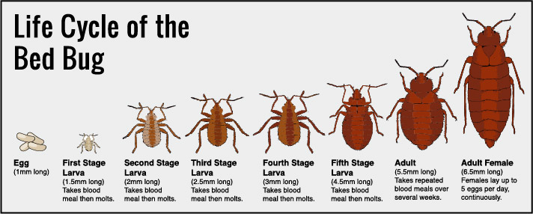
Bed Bug 101

Slide 8
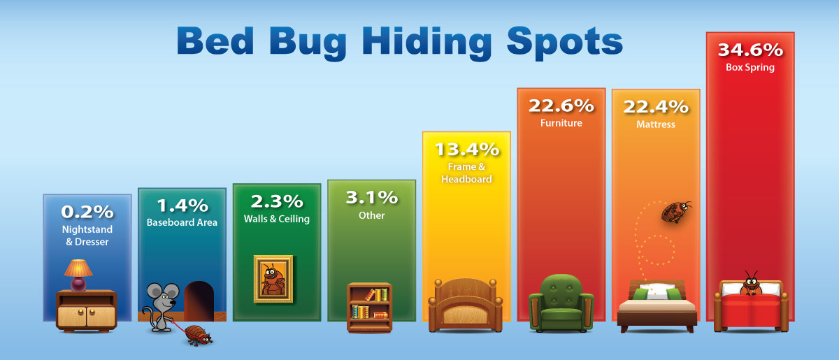
Bed Bug 101

Slide 9
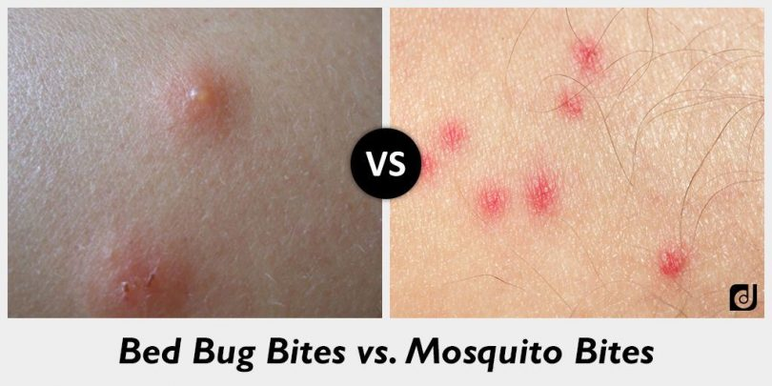
Bed Bug 101

Slide 11
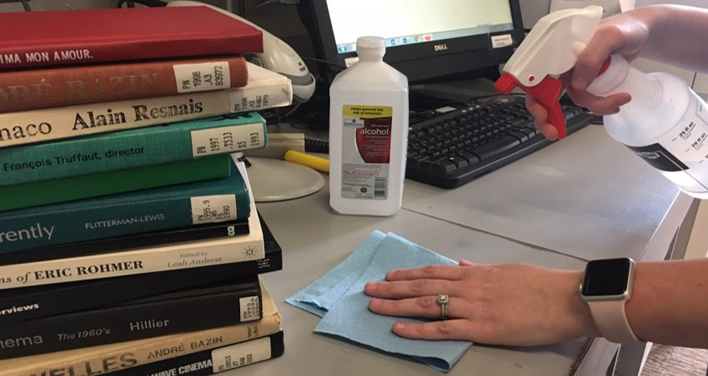
Prevention Tips
Training

Slide 12
Prevention Tips
Canine
Inspection

Slide 13
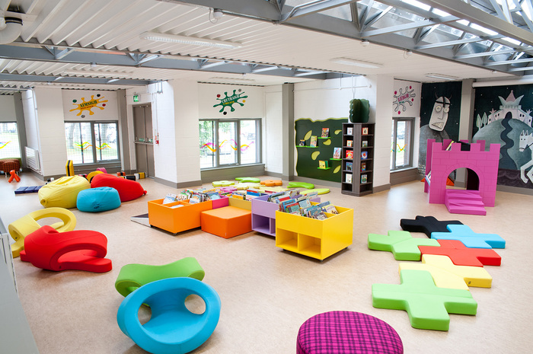
Prevention Tips
Assess Furniture

Slide 15
Prevention Measurements
Community Resources

Slide 16
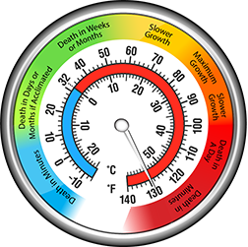
Treatment Tips

Slide 17
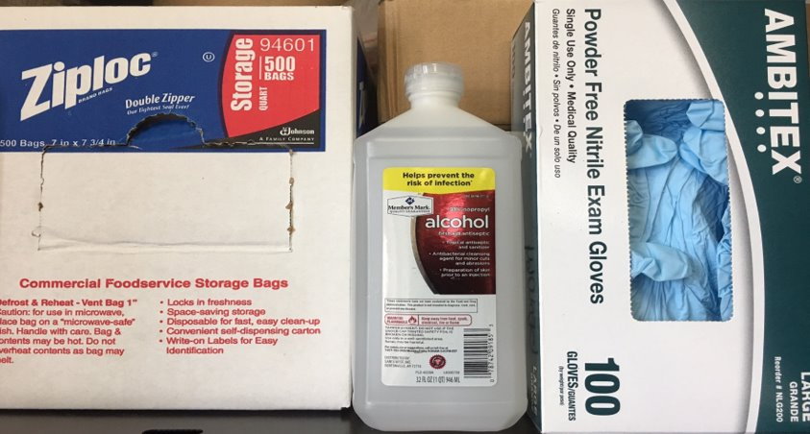
Treatment Tips
Possible Tools

Slide 18
Conclusion
Train
Prevent
Treat
Collaborate

Slide 20
Images & References
Images
Is it … Bed Bugs - https://pestmax.com/bed-bugs/top-signs-you-have-bed-bugs/
Bagged books - https://mobiusconsortium.org/bed-bugs-best-practices
Bed Bug Biology and Behavior - https://www.slideshare.net/vastateparks/bedbug-training
Life Cycle - http://thebugskiller.com/how-to-detect-resolve-and-prevent-problems-with-a-bed-bug-infestation/
Bed Bug Hiding Spots - http://mattresssafe.com/where-do-bed-bugs-hide/
Bed Bug Bites vs Mosquito Bites - https://www.differencebtw.com/difference-between-bed-bug-bites-and-mosquito-bites/
Bookworm - https://www.corkyspestnetwork.com/weekly-toons-2016.html
Training – Personal Picture
Canine Inspection - http://www.greendogpestservice.com/services/
Library Furniture/Stacks - https://systemcenter.com/markets/education/library-furniture/; https://www.schoolfurnishings.com/products/library/; http://creativelibraryconcepts.com/library-shelving/; http://www.lyponline.com/new-jersey/ramsey/photos/children-furniture-34
Newspaper - http://www.pestworld.org/all-things-bed-bugs/history-of-bed-bugs/
Community Resources - https://npmapestworld.org/ ; ; https://www.advancedk9bbs.com/ ; https://www.epa.gov ; https://www.thisiscolossal.com/2017/06/enchanting-libraries-by-photographer-thibaud-poirier/
Treatment - https://www.dougsbugco.com/bedbugs/; https://studyqa.com/chemical-engineering;
Treatment (Possible Tools) – Personal Picture
Love your library - http://hudsonarealibrary.org/2012/02/love-your-library-buy-a-heart/love-your-library/
Bed bug Questions - https://www.sylvane.com/bed-bug-faq.html

Slide 21
Images & References
Research
Rukke, B., Sivasubramaniam, R., Birkemoe, T., & Aak, A. (2018). Temperature stress deteriorates bed bug (cimex lectularius) populations through decreased survival, fecundity and offspring success. Plos One, 13(3), e0193788. doi:10.1371/journal.pone.0193788
Dang, K., Doggett, S. L., Veera Singham, G., & Lee, C. (2017). Insecticide resistance and resistance mechanisms in bed bugs, cimex spp. (hemiptera: Cimicidae). Parasites & Vectors, 10(1), 318-31. doi:10.1186/s13071-017-2232-3
DeVries, Z., Santangelo, R., Barbarin, A., & Schal, C. (2018). Histamine as an emergent indoor contaminant: Accumulation and persistence in bed bug infested homes. Plos One, 13(2), e0192462. doi:10.1371/journal.pone.0192462
Other sites
Colorado Department of Public Health and Environment, Bed Bug Infestation - https://www.colorado.gov/pacific/cdphe/bedbug-infestations
National Conference of State Legislator, State Bed Bug Policy - https://www.ncsl.org/Portals/1/Documents/environ/envhealth/Bed_Bug_PP_11-16.pdf

