Slide 1
E-Resources in Prospector
Do’s and don’ts

Slide 2
Agenda
Documentation available
Encoding level
001
Know your loader
ISBN/ISSN
Shared/lendable packages
Item record
856 field
Notes:
Cynthia & I are going to talk a bit about e-resources and how they match, overlay, and display in Prospector. Years ago, you may remember a common topic of discussion was whether to combine print and e on one record or to have them on separate records. In the Prospector environment, it was decided to keep formats separate. I think many of us made the same decisions in our local environments. For Prospector, there are a few practices we need to follow in loading e-records to ensure proper overlay and to prevent matching on print records.

Slide 3
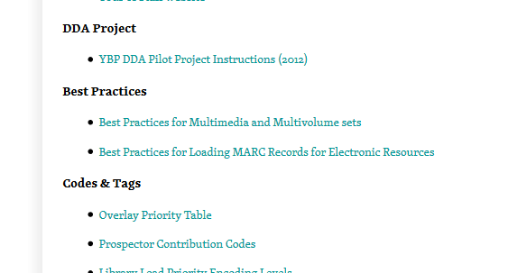
Documentation
Prospector best practices – loading marc records for electronic resources
https://www.coalliance.org/catalog-reference-committee
Notes:
Rose has already shown you where to find information regarding Prospector cataloging practices. Most of the info Cynthia & I will cover today is taken directly from the “Best Practices for Loading MARC Records for Electronic Resources” document available on the Cat/Ref site.

Slide 4
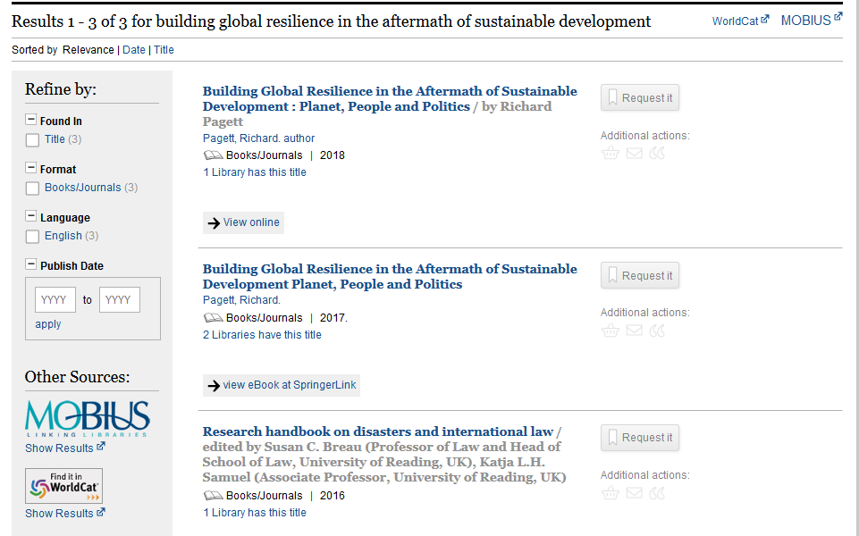
Notes:
So, we all understand the issue—here’s an example. The first two records here are probably for the same resource, but we have two records. Different libraries get records for Springer titles from different sources. Some of us use OCLC and some get the records directly from Springer. For the three holdings here, two libraries have loaded records from Springer and one has an OCLC record. I’ll come back to this in a bit, but where the OCLC record is may end up surprising you.

Slide 5
Encoding level
Should be “u” or “l” for batch loads of e-resources
Encoding level may be changed pre-load using marcedit or post-load in global update
Notes:
When you have a batch of e-resource records, one of the things you want to do is change the encoding level. Most of our print resource have an encoding level indicating full-level cataloging. If the e-resource encoding level is changed to a lower option, this helps ensure that it will not overlay the print record. In our best practice documentation, we are told to use an encoding level of u or l. I always change my batches to the u encoding level, and this can be accomplished in either MarcEdit before you load the records or in Sierra after you load them.

Slide 6
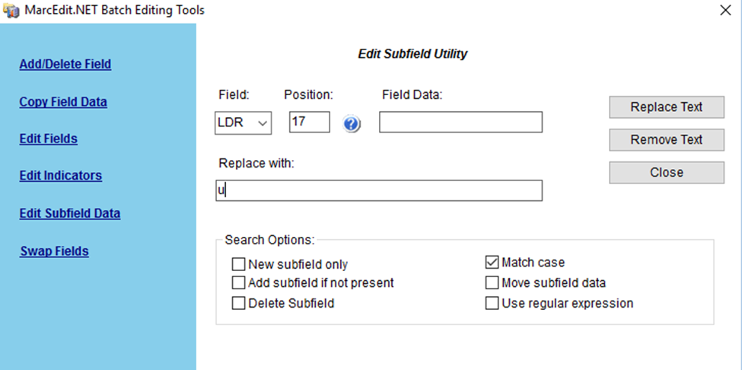
Changing encoding level using marcedit
Use the Edit subfield utility
Field = LDR
Position = 17
Leave field data blank
Replace with = u
“replace text”
Notes:
To make the change in MarcEdit, use the edit subfield utility. The field will be LDR, position 17. Leave the field data blank, and put a u (or l) in the replace with box. Click the “replace text” button.

Slide 7
Changing encoding level in sierra global update
Notes:
In Sierra, you can make the change in the global update function. You’ll need to have the records you want to update in a list before you do these steps. Once you have your list selected in global update, you’ll use the Change Special Field command input option. Complete the options in the dialog box as shown and then click “ok”. I think most ILS systems we are using have a global update tool, so those of you on other systems should be able to use similar steps to do this task.

Slide 8
001 field
Standard III loader strips Oclc prefix (ocm, ocn, on) from 001
Vendor records generally have some prefix that reflects vendor/source name (ssj=serials Solutions, ebc=proquest ebook central)
Know your loader. What does it do to the 001?
no letter prefix=oclc record, so if it is not an oclc record make sure you have a prefix in the 001 after loading!
do an oclc number search in prospector to see if records with that vendor prefix are already There. If so, do the titles match?
Notes:
One of the most important things to be aware of is the 001 field. Talk about “on” & changes needed to some of UNC’s loaders.

Slide 9
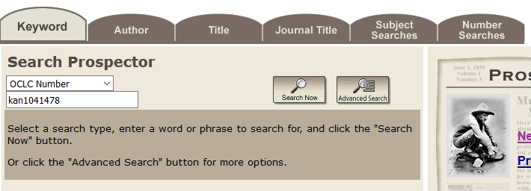
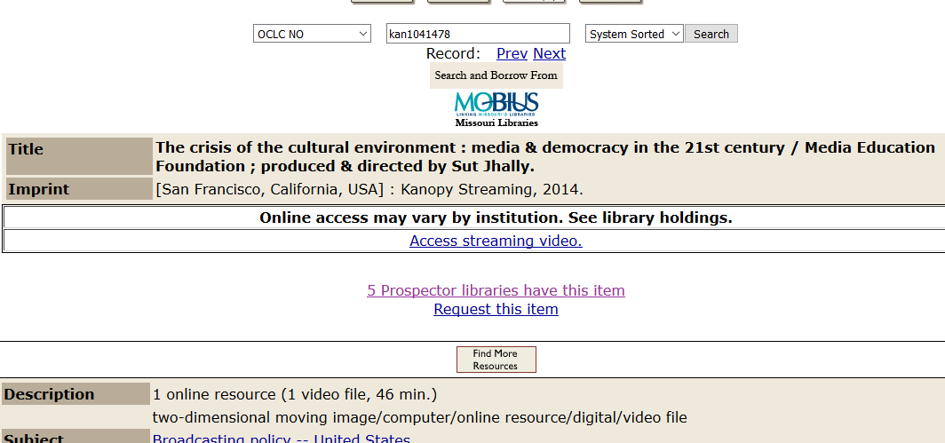
Notes:
To search Prospector for 001 numbers, you need to be in the Classic catalog view.

Slide 10
Isbn/issn
Put print/other format isbns in subfield z
Print isbns in e-resource records may cause overlay with a print version record

Slide 11
Notes:
So, let’s go back and take a closer look at these two records for the same title.

Slide 12
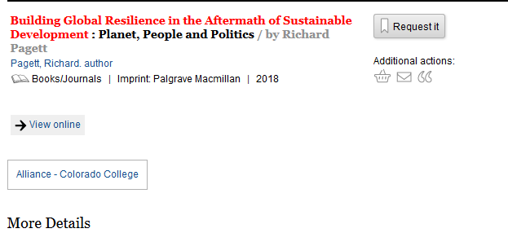

Slide 13
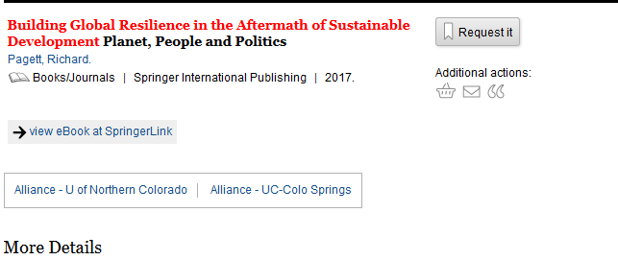

Slide 14
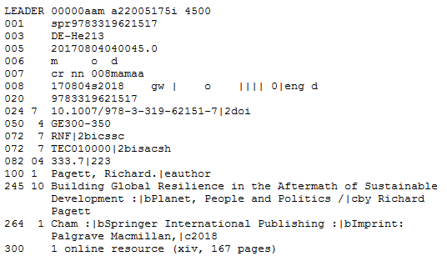
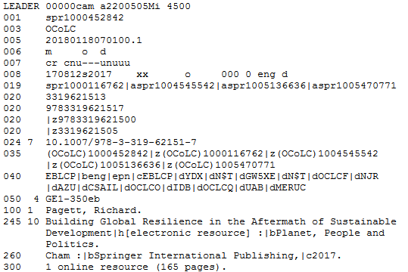
Notes:
The one on the left is the 1-holding record from Colorado College. The one on the right is the UCCS and UNC record. Both master records have a record source from Springer as you can see in the 001s.

Slide 15
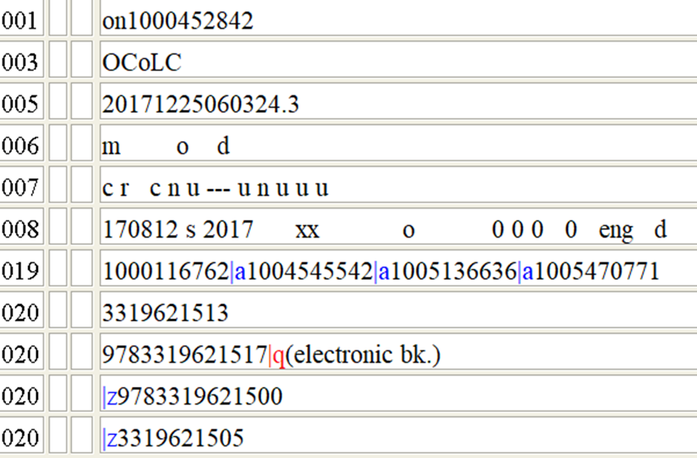
Notes:
However, our record is an OCLC record (and one with the loader problem I mentioned earlier). It has attached to the record from UCCS despite the 001 difference. This is because the matching algorithm Rose/Karen mentioned earlier today, title key, ISBN, etc. So, in this instance it is a good match.

Slide 16
Shared/lendable packages
Springer/Elsevier
coding in item record facilitates loaning
Notes:
Just a quick note here about item record coding for our shareable Springer/Elsevier packages. Most e-resources in Prospector are not accessible unless you are affiliated with the holding institution, but for these two packages, other users may request titles. That lending is accomplished through coding in the item records. This is from one of our Springer titles. There are other packages that are shared between multiple institutions: for example, the Alliance DDA titles are accessible for users in all of the participating libraries.

Slide 17
Prospector best practices
856 display differences

Slide 18
Electronic record 856 display when the master record has no item attached
Notes:
No longer a lot of difference between records with items attached, and those without. However, there are some display differences between Classic catalog and Encore depending on whether the URL is in the bibliographic record, or in the item record.

Slide 19
Item view of 856 display in Encore for master record with no item record
Notes:
Notice the display for Basalt – “Online” but no clickable URL; No local holdings note for Jeffco.

Slide 20
856 display in Classic catalog view of master record, no item
Notes:
URL for master record displays above the Holdings section. Notice the URL display for Basalt; copy information unavailable for Jeffco and Univ. of Wyoming because there are no item records attached.

Slide 21
856 display with item record attached
Notes:
Notice – “local use only” and RBDigital call number.

Slide 22
Classic catalog display with item attached
Notes:
Notice “local use only” note and “RBDigital” call number.

Slide 23
Classic catalog view of master record with URL in the item rather than the bib
Notes:
Note there is no URL displaying above the individual holdings. Jeffco’s URL for the cover art is not showing because only one URL can display in an item record. In Classic catalog, the item URLs are active.

Slide 24
Browse display with item URL in master record
Notes:
Notice that no electronic link is displaying. A user would have to click on the title to get to any of the links.

Slide 25
Encore display with URL of master record in the item
Notes:
Notice that the links are not live for Jeffco or Basalt. While item URLs work in Classic Prospector, they do not work in Encore.

Slide 26
856 display suggestions
Put 856 in bibliographic record rather than item if possible since Encore item URLs are not active
If item URL is required, make sure to set the encoding level so you are not the master record
Add item records if you want call number, holdings or status information to display

Slide 27
Questions?
Jessica Hayden
Technical services manager
University of northern Colorado
Jessica.hayden@unco.edu
Cynthia Wilson
Cataloging, database maintenance, receiving & processing supervisor
Jefferson county public library
Cynthia.Wilson@jeffcolibrary.org

