Slide 1
SWIFT Migration to Prospector 2022 / 2023 Update
Colorado State Library

Slide 2
SWIFT Migration: A Very Brief History
October 2020 - present
Plan: Migrate @150 SWIFT VDX Users to Prospector
Several distinct user groups identified:
Direct connections to Inn-Reach/Prospector
6 Marmot Sierra libraries
2 Stand-alone Sierra libraries
API Direct to Inn-Reach/Prospector (D2IR)
2 Polaris libraries
75 AspenCat public, academic, special & correctional libraries
Resource Sharing Broker (RSB) connections
36 Public, community college, and correctional libraries staff initiated only
28 Public, community college, and correctional libraries Full Borrowing & lending

Slide 3
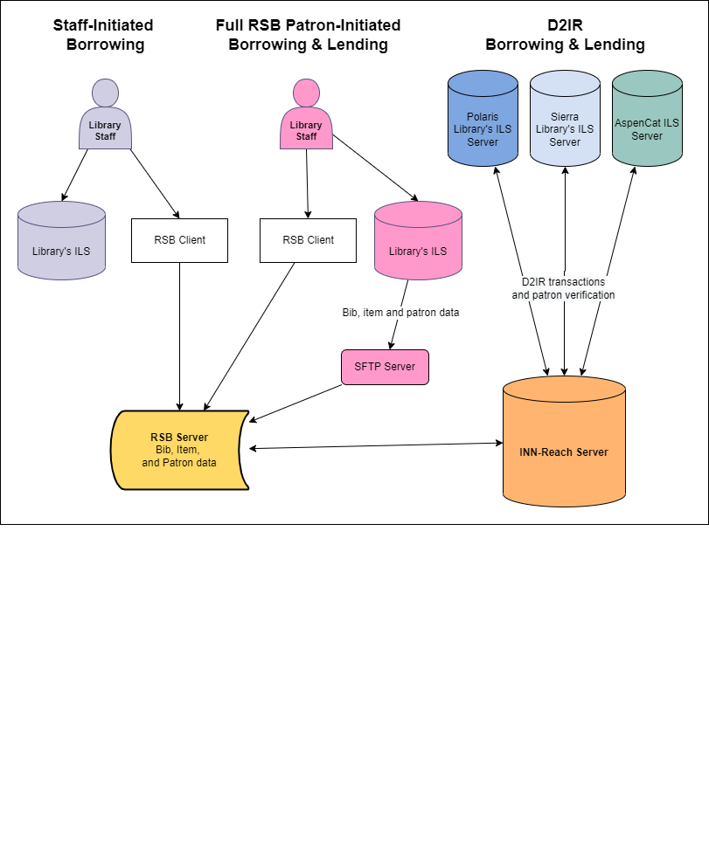

Slide 4
SWIFT Migration: Where We Are Now In a Nutshell
Direct connections to Inn-Reach/Prospector
6/6 Marmot Sierra libraries
2/2 Stand-alone Sierra libraries
API Direct to Inn-Reach/Prospector (D2IR)
2/2 Polaris libraries
5/75 AspenCat public, academic, special & correctional libraries
Resource Sharing Broker (RSB) connections
23/36 Public, community college, and correctional libraries staff initiated only
23/28 Public, community college, and correctional libraries Full Borrowing & lending (lending only completed for 2)

Slide 5
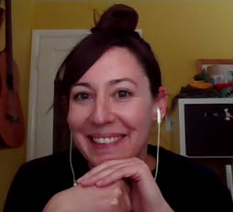
Primary Resource: Human Support
swift-support@coloradovirtuallibrary.org
SWIFT Program Manager:
Marisa Wood
Resource Sharing Senior Consultant
Colorado State Library
mwood@coloradovirtuallibrary.org
303-351-2338
***swift-support@coloradovirtuallibrary.org***

Slide 6
Additional Resources: SWIFT Plus (+)
LendILL@denverlibrary.org
Formerly known as NoStop
Facilitates requests for out-of-state material through partnership with Denver Public Library
No fee to place SWIFT + requests**

Slide 7
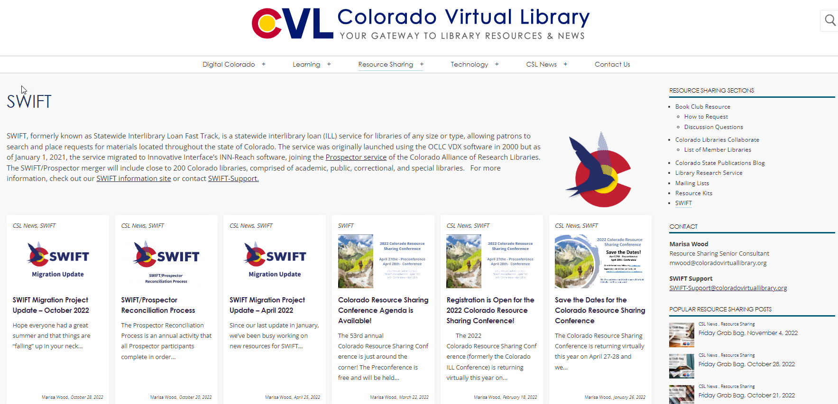
Additional Resources: SWIFT Landing page on CVL.ORG
https://www.coloradovirtuallibrary.org/resource-sharing/swift/

Slide 8
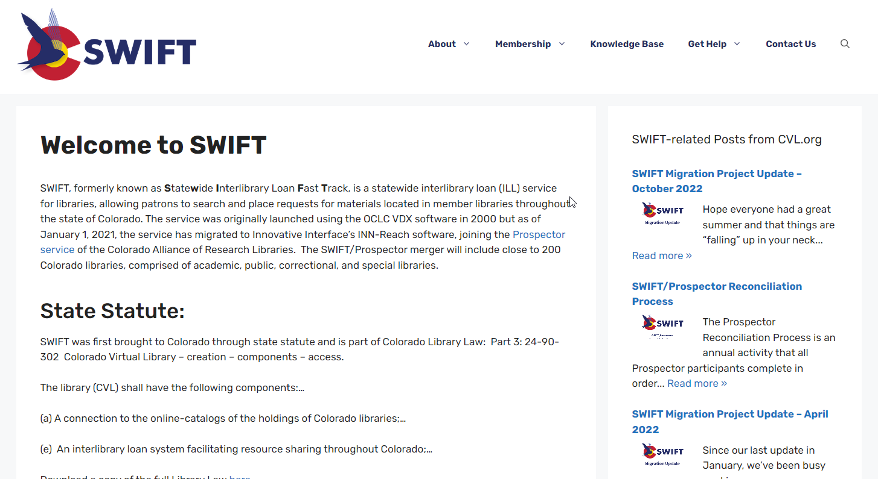
Additional Resources: SWIFT Information & Support Website
https://swift.cvlsites.org/

Slide 9
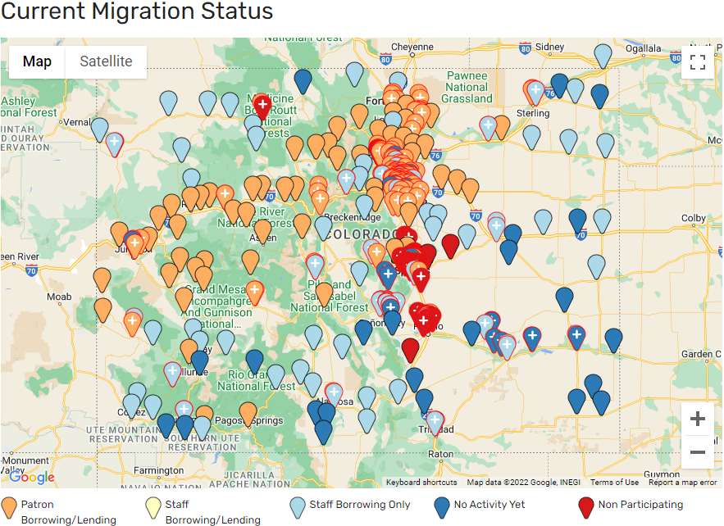
Additional Resources: SWIFT Information & Support Website
https://swift.cvlsites.org/

Slide 10
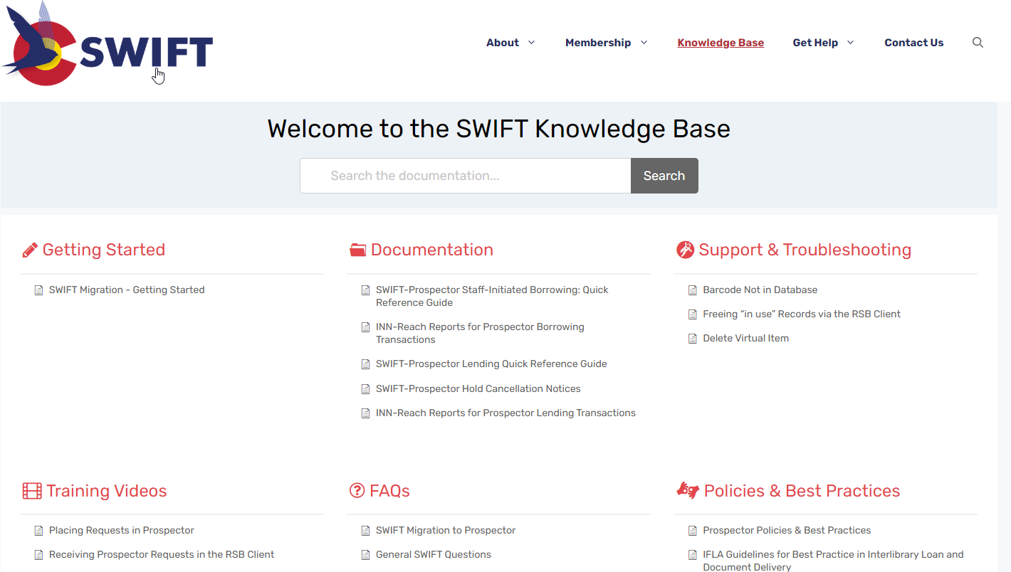
Additional Resources: SWIFT Knowledge Base
https://swift.cvlsites.org/knowledge-base/

Slide 11
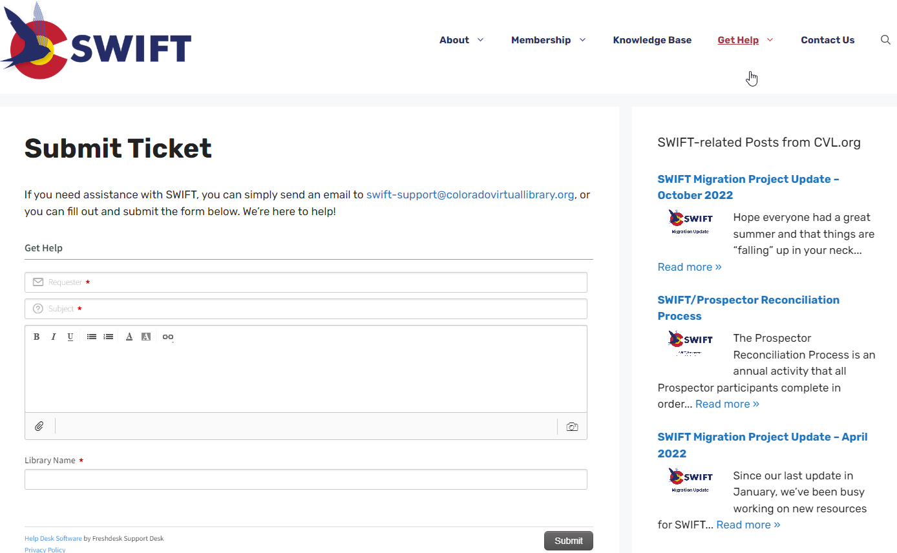
Additional Resources: SWIFT Support Ticketing System
https://swift.cvlsites.org/submit-ticket/

Slide 12
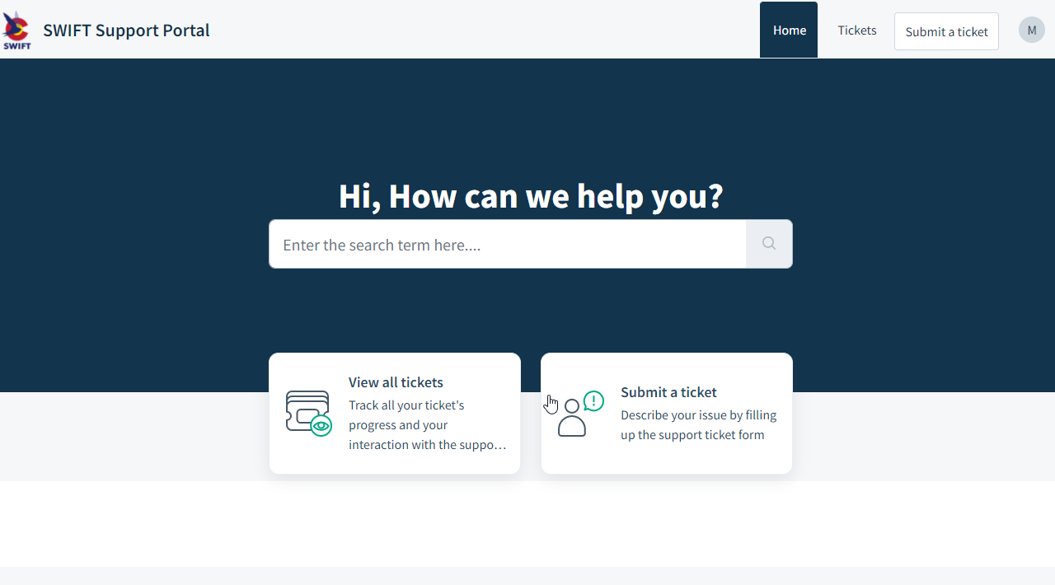
Additional Resources: SWIFT Support Portal
https://swift-support.freshdesk.com/support/login

Slide 13
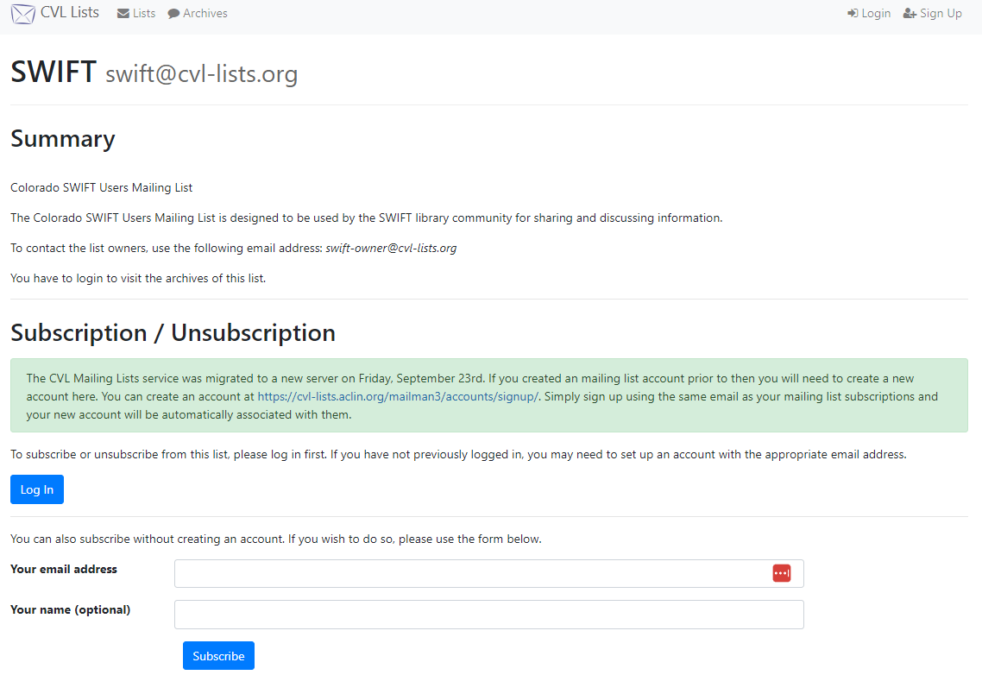
Additional Resources: SWIFT Member Mail List
https://www.cvl-lists.org/mailman3/postorius/lists/swift.cvl-lists.org/

Slide 14
SWIFT Migration: What’s Next?
?

Slide 15
SWIFT TEAM: swift-support@coloradovirtuallibrary.org
Marisa Wood
Resource Sharing Senior Consultant
Colorado State Library
mwood@coloradovirtuallibrary.org
Regan Harper
Director, Networking and Resource Sharing
Colorado State Library
harper_r@cde.state.co.us
Thank You!

