Slide 1
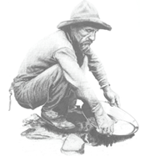
Why Does Do That?
Understanding the Union Catalog
Cataloging/Reference Meeting
15 February 2018
Karen Neville, Library Director, RRCC

Slide 2
Why does Prospector…
Merge some records and duplicate others?
Sometimes require me to select which copy I want and sometimes decide for me?
and
How do I influence what appears in the union catalog

Slide 3
Why does Prospector…
Merge some records and not others?

Slide 4
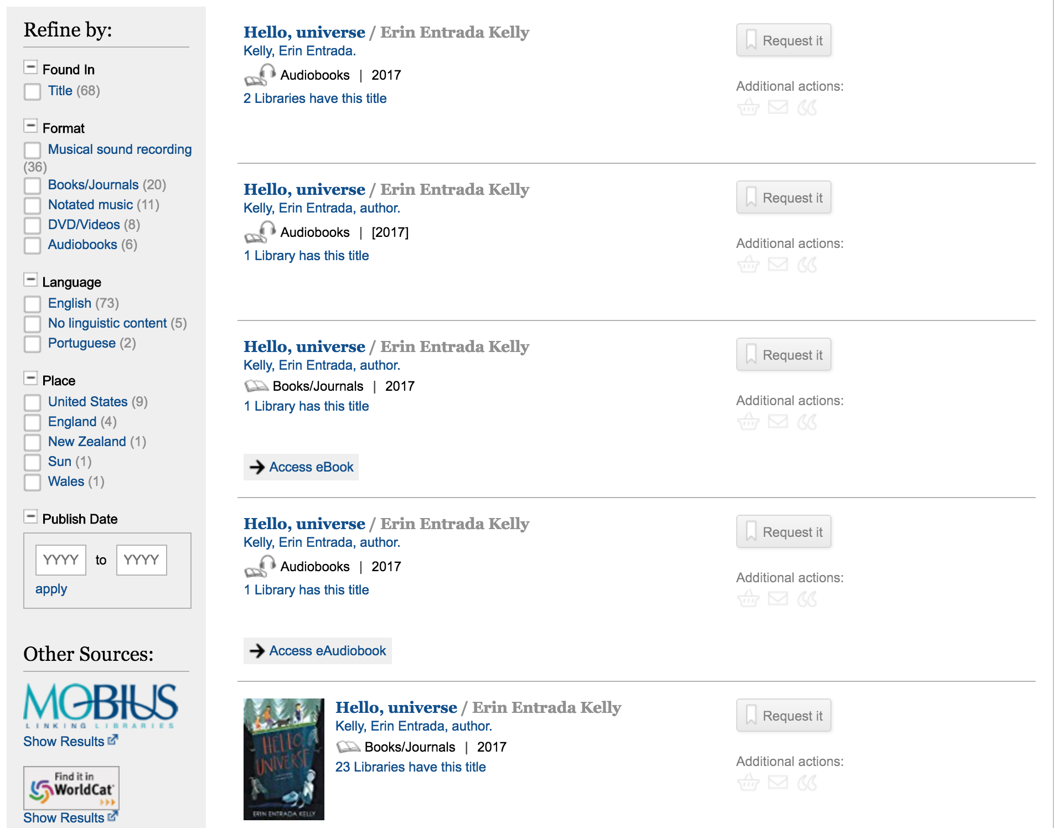

Slide 5
Matching Algorithm
001 and the first three letters of the title OR
020 and the first three letters of the title

Slide 6
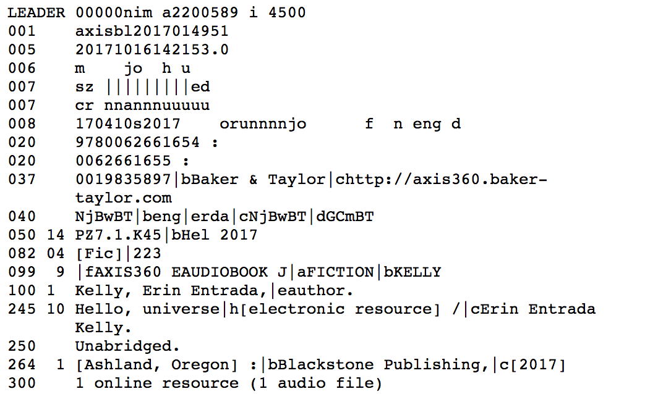

Slide 7
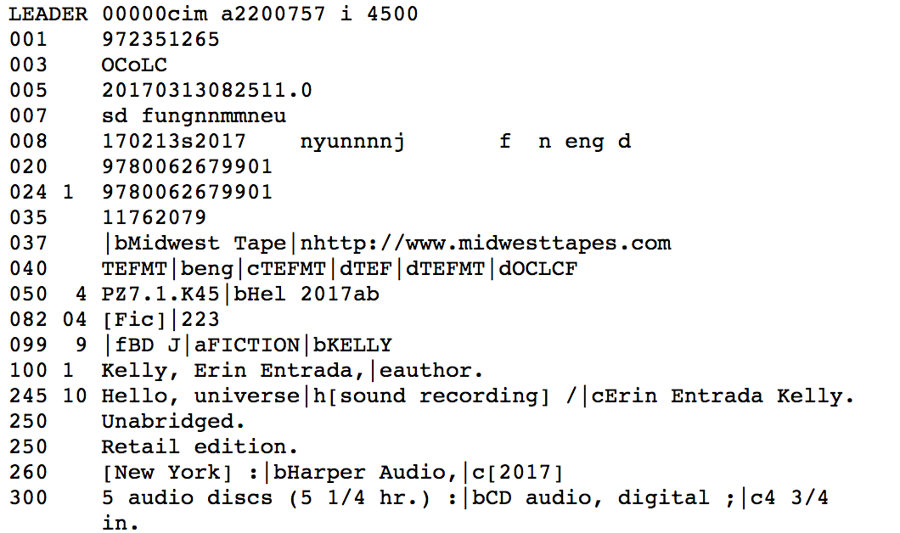

Slide 8
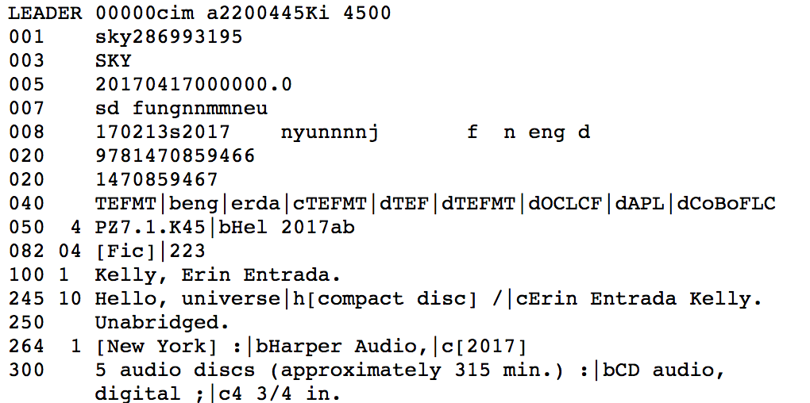

Slide 9
Whose record wins?
The highest encoding level
The library with the higher overlay priority
The record cataloged first
https://www.coalliance.org/catalog-reference-committee

Slide 10
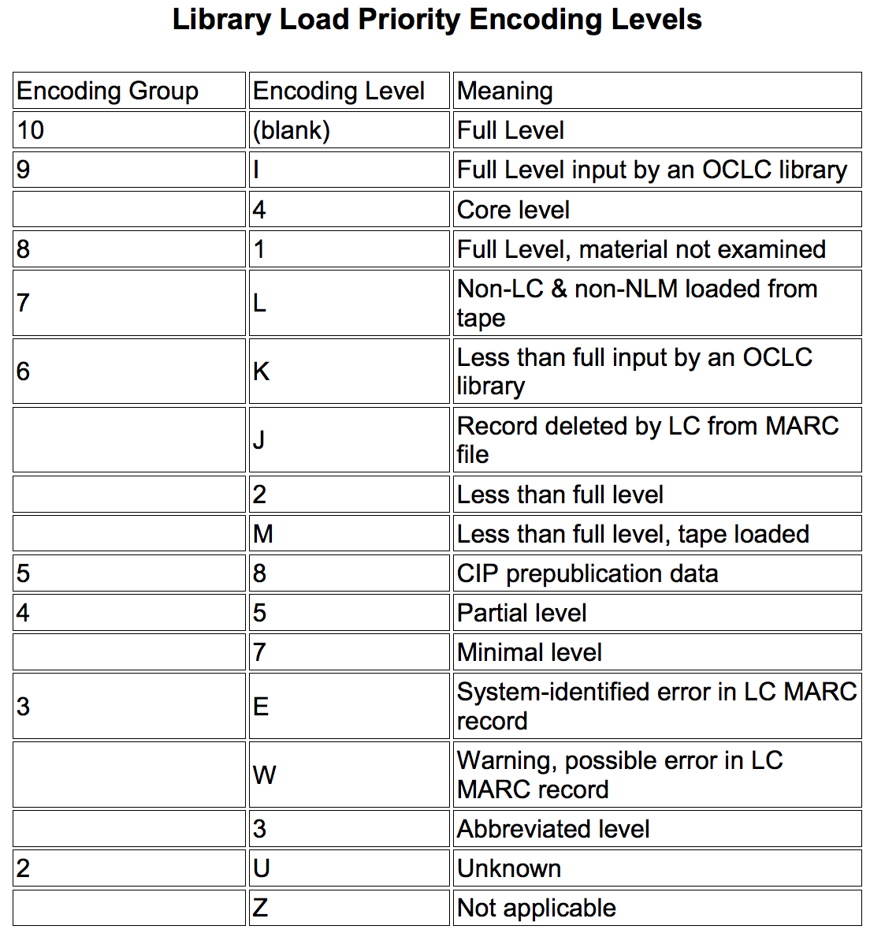

Slide 11
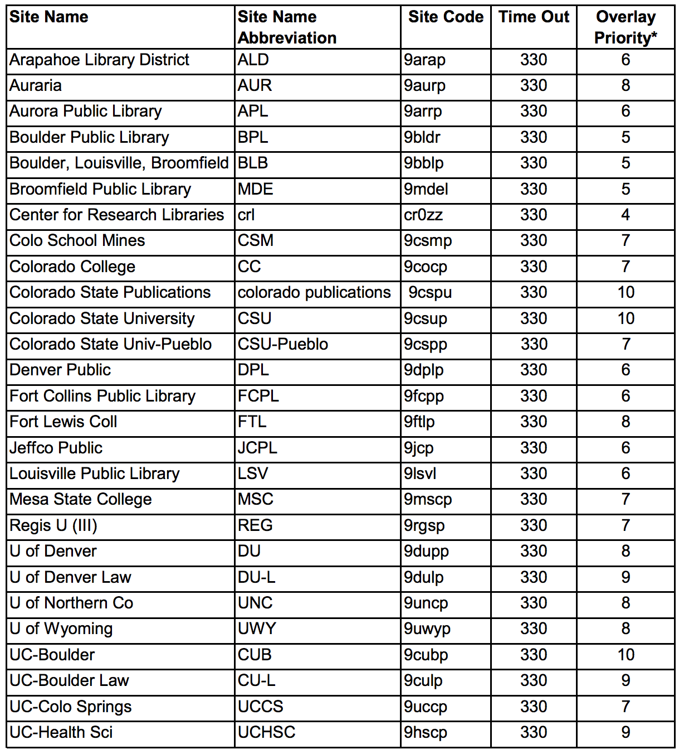

Slide 12
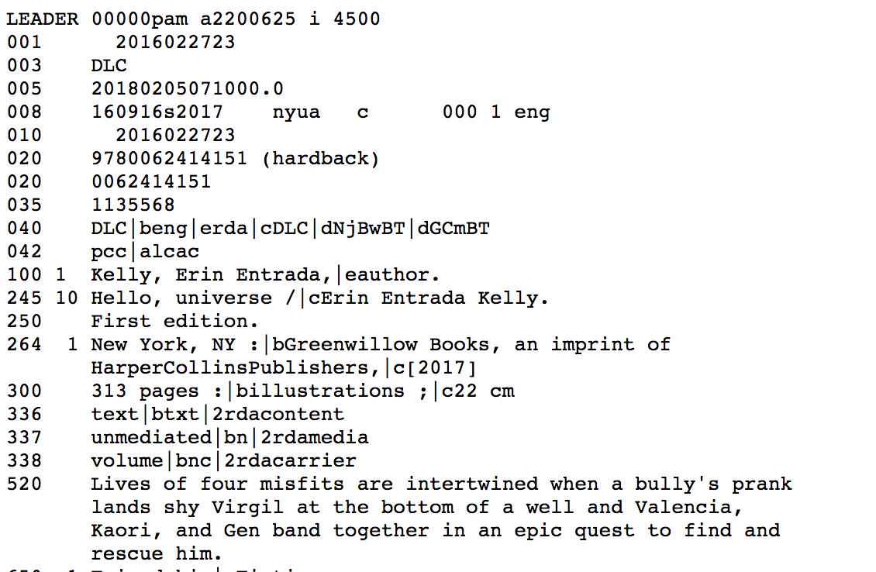

Slide 13
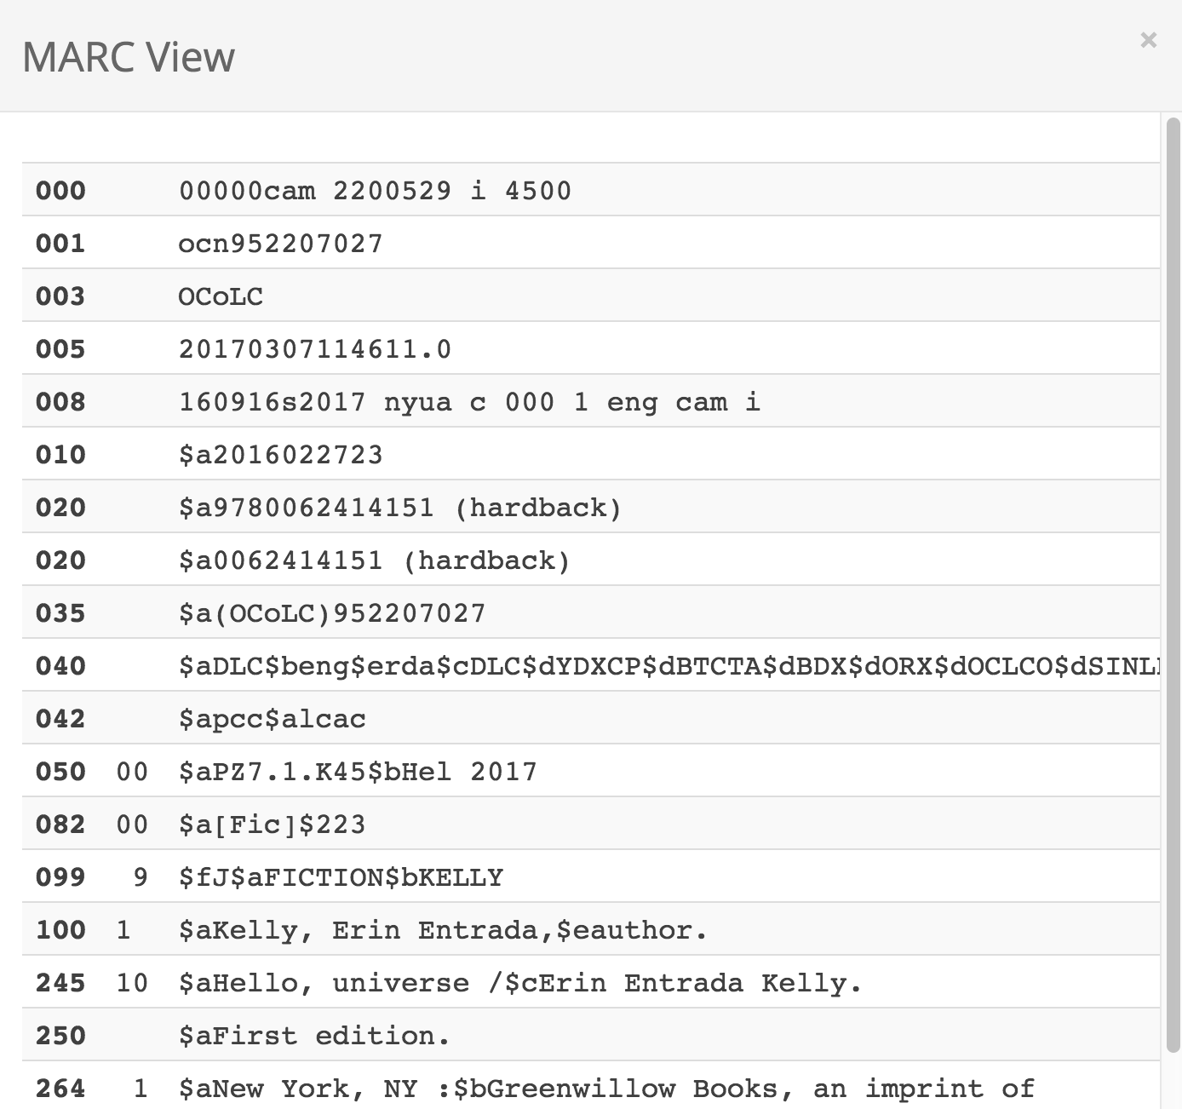

Slide 14
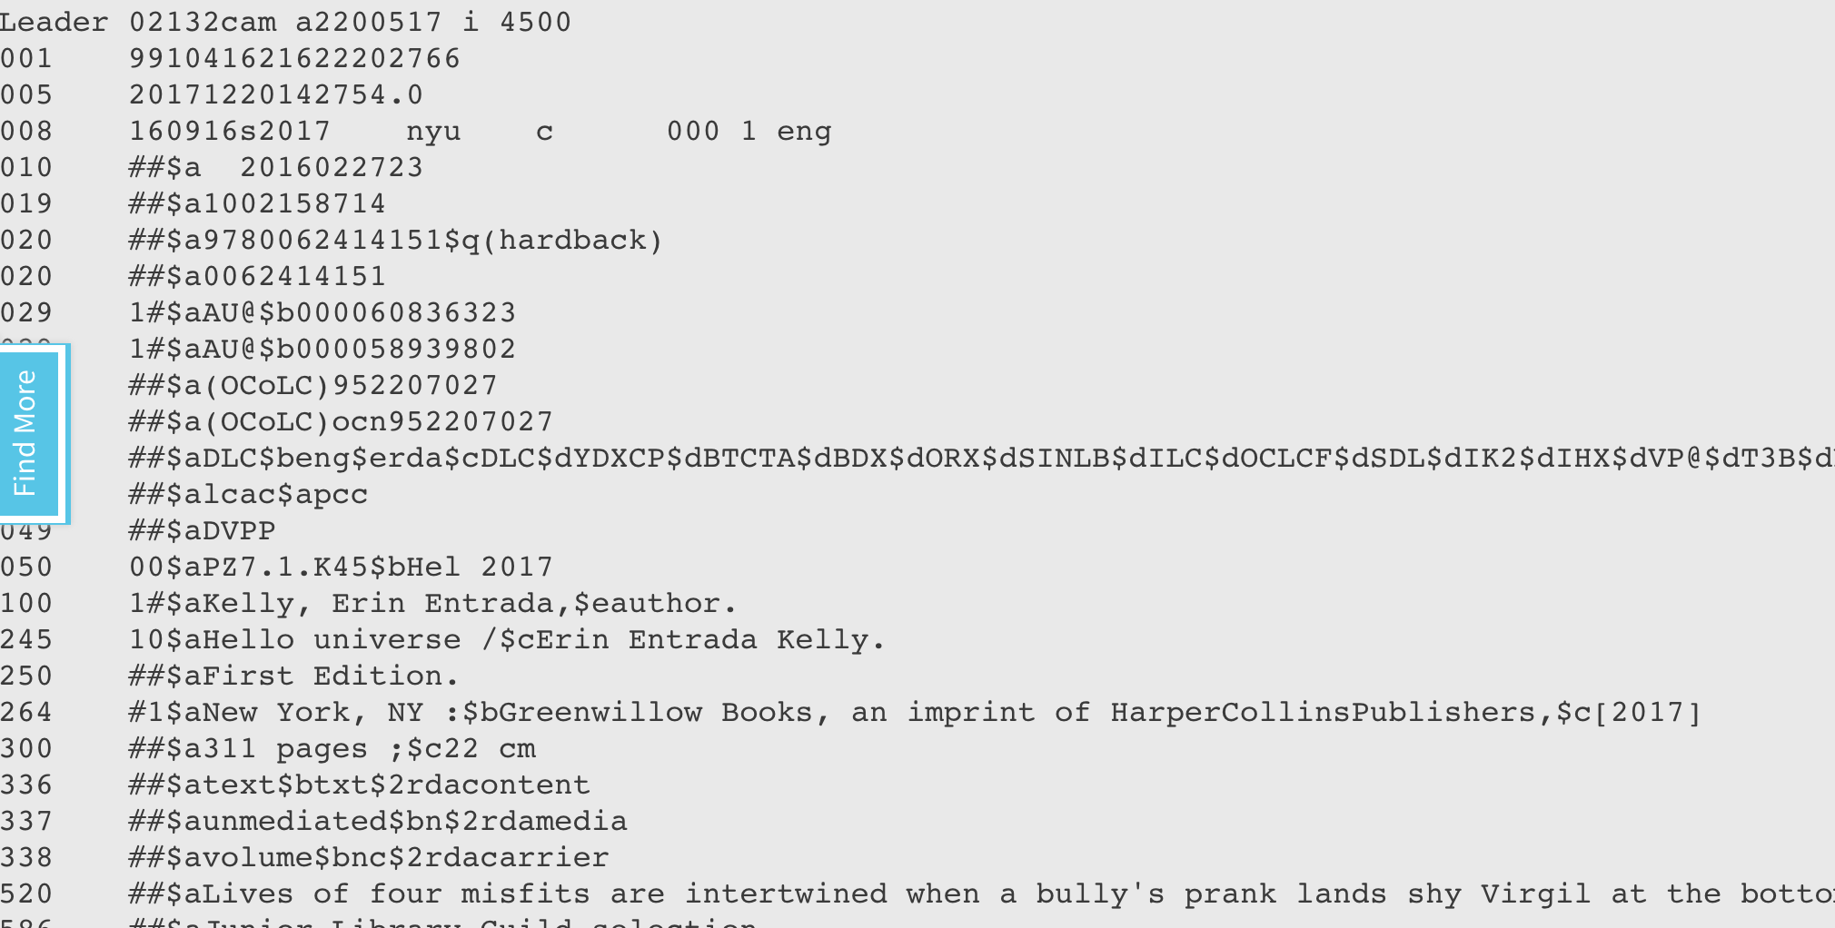

Slide 15
Is there any way to know…
Whose master record Prospector is using?
This information is available through the telnet version of Prospector.
Prospector FAQ

Slide 16
Why does Prospector…
Sometimes require me to select which copy I want and sometimes decide for me?

Slide 17
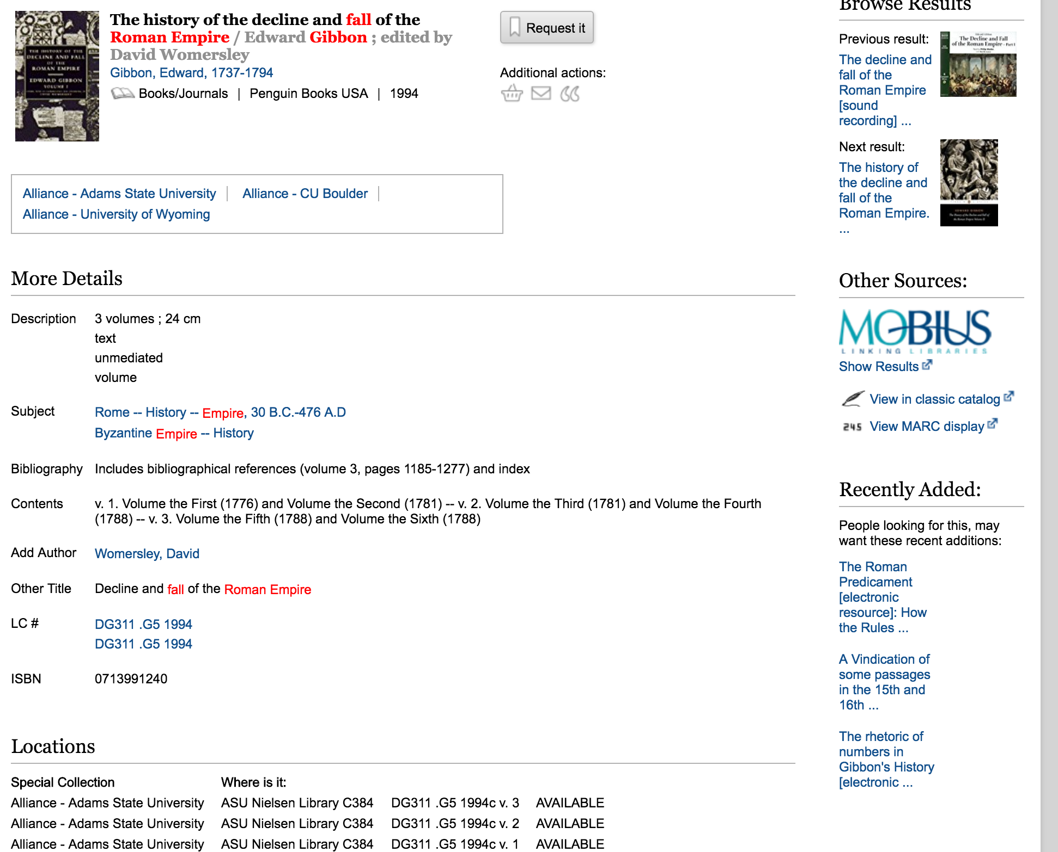

Slide 18
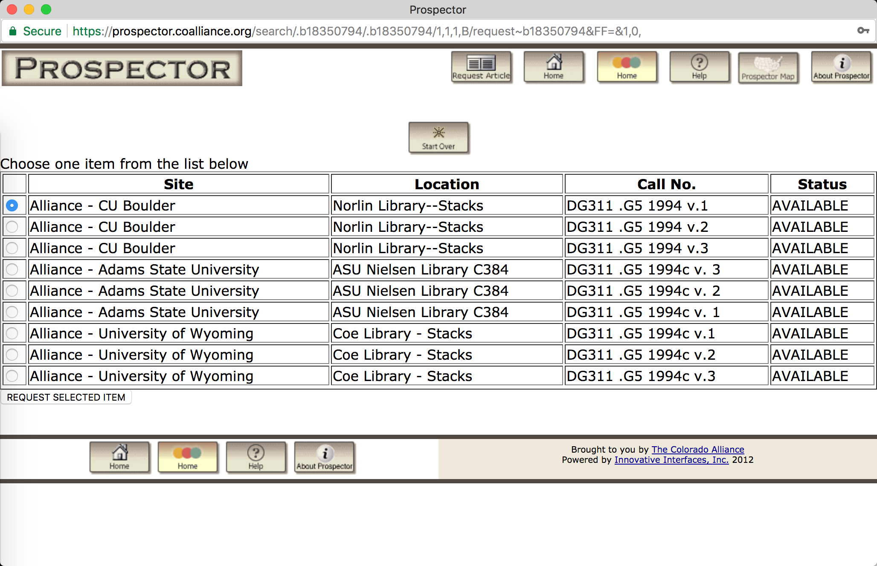

Slide 19
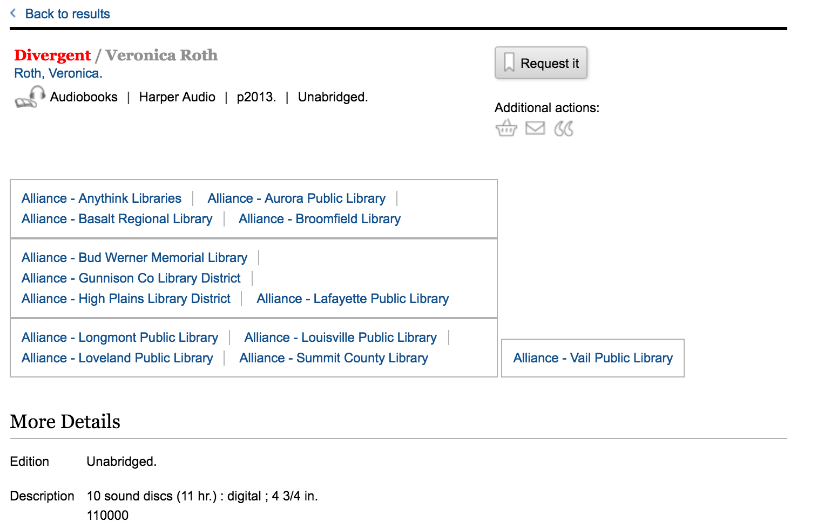

Slide 20
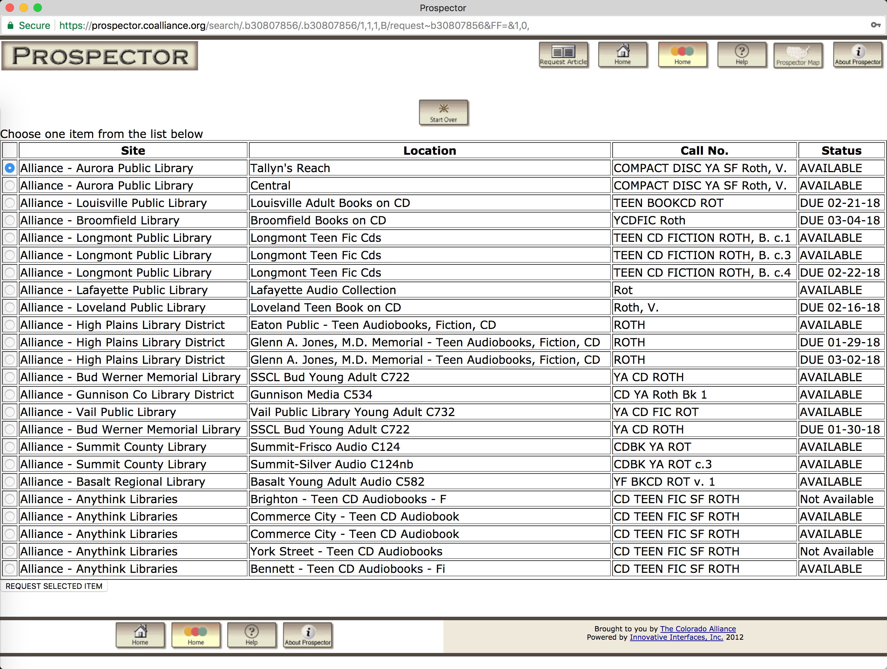

Slide 21
Multivolume Set Best Practices
Model one, exhibit A – Single bibliographic record, single item record
Model one, exhibit B – Single bibliographic record, multiple item records
Model two – Separate bibliographic records for individual parts
Best Practices Document

Slide 22
How do I…
Influence what appears in the union catalog?
001 field
Note: any agency other than OCLC must have an alphabetic prefix
020 field
‡z Canceled/Invalid ISBN

Slide 23
Questions?
Karen Neville
Library Director
Red Rocks Community College
karen.neville@rrcc.edu

